Slide 1


Comprehensive Postvention Response: Lessons Learned from Two Oregon Counties
Debra Darmata, MS - Suicide Prevention Coordinator, Washington County
Jeffrey Anderson, Clackamas County
Notes:
Introduction: 8 minutes—each person gets 2 minutes to describe local landscape,
Roger: 15 minutes
Whitney: 15 minutes
Galli: 15 minutes (could do 10)
Deb: 10 minutes
Conclusion: 1 minute
Q&A: 10 minutes

Slide 2
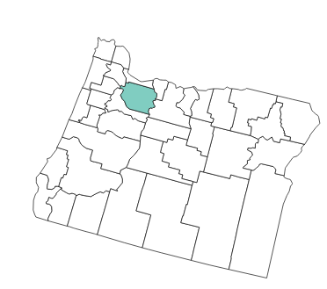
Clackamas County
Galli Murray, MSW- Suicide Prevention Coordinator

Slide 3
Clackamas County
As required by the permanent administrative rules implementing Senate Bill (SB) 561, Youth Suicide Communication and Post-Intervention Plan from Oregon’s 2015 Regular Session, Clackamas County Behavioral Health has developed a Communication and Response Protocol. The rules identify Local Mental Health Authorities (LMHAs) as the entities responsible for initiating and coordinating the community response to each case of suicide which meets the criteria established in SB 561.
The rules have three purposes:
  To establish minimum standards for the communication protocol and post-intervention protocol to address suspected youth suicide.
  To reduce the risk of contagion among individuals 24 years of age or younger after a suspected youth suicide by establishing overall guidelines for communication and post-intervention response protocols for effective communication and response by local agencies, groups, or individuals.
  To establish the process for LMHAs to report suspected youth suicides to the Oregon Health Authority within seven (7) days of the death.
Notes:
Before 561, the county did not offer postvention supports as standard practice.
Language taken from the SB 561 perm rules and our SB 561 protocol.

Slide 4
Postvention Pathway
Medical Examiner’s responsibilities will be to notify the Local Mental Health Authority (LMHA) Designee of the death by suicide in Clackamas County of a 10 - 24 year-old within 72 hours of death, and to identify individuals including the bereaved family, family of choice, friends, professionals, peers and those with geographic, social or social media ties to the deceased for targeted postvention response.
Notes:
Language taken directly from SB 561 final rules.
Because of the positioning in the county of the ME office and BHD, an MOU between Medical Examiner and Clackamas County Behavioral Heath was developed.

Slide 5
Inter-Departmental Agreement Established
Medical Examiner will notify Behavioral Health Division of individual(s) linked to the deceased through residency, employment, school attendance, or significant family or social ties. The purpose of this communication is to inform and mobilize postvention response to a death by suicide.
This Agreement is intended to memorialize the expectations of the departments involved but does not constitute a binding legal contract.
This notification requirement is done pursuant to Oregon State Bill 561 (2015)
Agreements of Departments
  Disaster Management Medical Examiner agrees to:
  Communicate relevant information of individual(s) linked to youth who have died by suicide and are residents of Clackamas County at the time of their death.
  Health, Housing, and Human Services, Behavioral Health Division agrees to:
  Use the information to inform and guide postvention efforts within Clackamas County.
Notes:
Language taken from the MOU – happy to share this with others.

Slide 6
Postvention Pathway
Community partners also provide information for the purposes of postvention response:
Law enforcement agencies
Trauma Intervention Program (TIP)

Slide 7
Postvention Pathway
LMHA Designee notifies Clackamas County Behavioral Crisis Team Supervisor of:
Name of decedent
Identified individuals and contact information for postvention response
Other pertinent information that will better inform postvention response
Notes:
How this information is shared and with who is a significant consideration. How this supervisor shares the information is also critical.
Mindful of exposure and secondary trauma to our staff by sharing minimum amount of info that is necessary with only the need to know people, confidentiality for the decedent and privacy for their loved ones.
2. Individuals but also impacted systems such as places of employment, school settings, church communities, etc.
3. This information typically comes from the ME or other first responders.
Examples – 1) family telling others that the death was accidentental despite cause of death being determined by ME as suicide; 2) divorced parents of minor youth in active conflict over the disposition of the decedent’s body (cremation vs. burial)

Slide 8
Postvention Pathway
Crisis Team Supervisor delegates Crisis Team staff member(s) to begin postvention outreach calls to identified individuals.
This team is referred to as the “Postvention Team” and is a sub-set of crisis team case managers and clinicians who have opted in to do this work.
With exposure to trauma for staff and privacy for those impacted in mind, this staff member goes to a private interview room (versus in open cubicles) to make outreach calls.
Notes:
Again, how this information is communicated by the supervisor to the identified staff member is crucial. This is not assigned but, instead, staff members “opt in” for each response.

Slide 9
Postvention Pathway
Crisis Team Postvention Staff will phone outreach to individuals with the following goals in mind:
Provide support for normal grief process and minimize complicated grief and guilt reactions to degree possible
Inform individual of resources in the community if they should want or need
Reduce risk of further suicidal behavior
Notes:
2. This can include connecting with their primary care doctor, the American Foundation for Suicide Prevention Survivor Outreach Program, their church community, suicide loss survivor support groups or mental health supports (including walking in at no cost to our mental health center to be seen).
3. Since we know the risk of suicide increases after an individual has experienced the death from suicide of someone close to them, we ask directly about thoughts of suicide.
The outreach calls can be to a place of employment to speak with the manager, church community to speak with the pastor or school setting, etc. The conversation includes what can we do to be helpful, what do you need?
These calls can range from very short to a significant amount of time. Communication with other team members is important.

Slide 10
Postvention Pathway
Crisis Team Postvention Staff will phone outreach to individuals and:
Ask if there is any one else that they know of that could benefit from an outreach call from the Postvention Team
Ask for permission to contact them again in the near future to offer additional postvention supports. Dates such as anniversaries, graduation, yearbook release, birthdays and any other identified dates should be considered
Document in the electronic health record
Notes:
After the call(s) are made, the agreement staff have made is that they will check in with someone. Supervisor, peer, etc. We recognize that this work is hard. Harder than what the average county mental health worker has signed up for. Taking care of our people is crucial.

Slide 11
Postvention Pathway
In some situations, the county of the deceased’s death is not the county of the deceased’s residency.
Memorandum Of Understanding (MOU) developed between Clackamas, Multnomah and Washington counties indicating that the LMHA County Designee in the county of residence is notified for the purpose of informing and mobilizing SB 561 postvention response to a death by suicide.
Before this agreement, no formal ability to communicate between these counties existed.
Notes:
SB 561 has set the stage for notification and communication for deaths from suicide of 10 – 24 y/o individuals but has left it up to the individual counties as to how this is operationalized. In tri-county area, we found that not being able to communicate created significant barriers for postvention.
Examples: youth attempted in Clackamas, was transported to Multco to trauma hospital for care and died while in Portland. Because we didn’t have a formal mechanism in place, Clackamas County would not have known about this death.
Resulting collaboration was a MOU. Happy to share this with others.

Slide 12
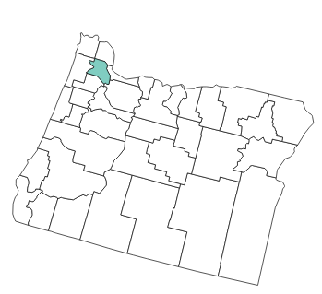
Washington County
Debra Darmata, MS - Suicide Prevention Coordinator

Slide 13
Suicide prevention
2010-2012
GLS Grant
Designated Suicide Prevention Coordinator
(Dec. 2012)
Suicide Prevention Council
(2013)
Regional Community Health Assessment Results (mid 2013)
SFR Planning Group Starts meeting (mid 2013)
SPC recommends creation of Suicide Fatality Review
Community Health Improvement Plan
(CHIP)
(Dec. 2014)
GLS Grant Received
(Oct. 2014 – Sept. 2019)
Hired Dedicated Suicide Prevention Coordinator
(August 2015)
Notes:
1) 2012 on of the Highest rates of about 19
2) 2013 Suicide Prev. Summit
3) 2013 SPC
4) 2014 CHIP priority
5) Late 2014 SFR

Slide 14
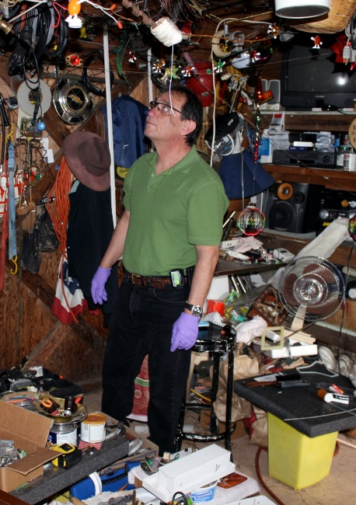
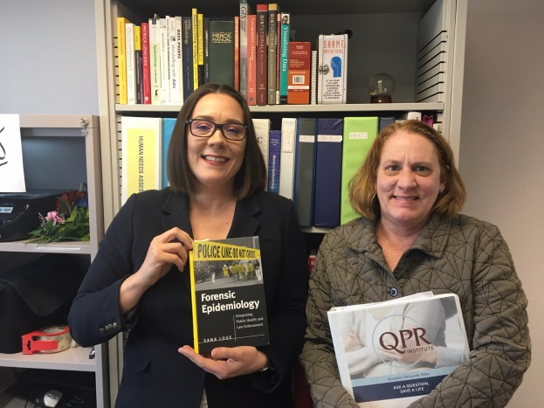
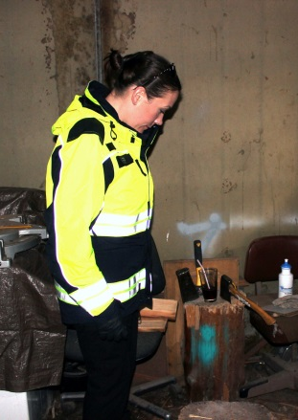
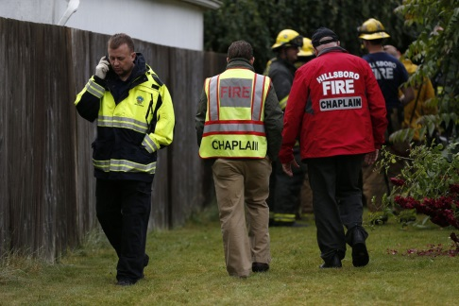
Three “Main Players”
Epidemiologist (Epi)
Suicide Prevention Coordinator
Deputy Medical Examiner (DME)
Collaboration Formation
all work for public Health
all work in same building

Slide 15
System Overview
Notes:
Death occurs and if determined that it is a suicide
DME will give pamphlet, be available, give resources
Will complete CRAP form ( Suicide Consolidated Risk Assessment Profile) along with the NVDRS (National Violent Death Reporting System
Six months following next of kin will be sent a letter out of DME
SFRB reviews 5 cases every quarter which is guides by a matrix

Slide 16
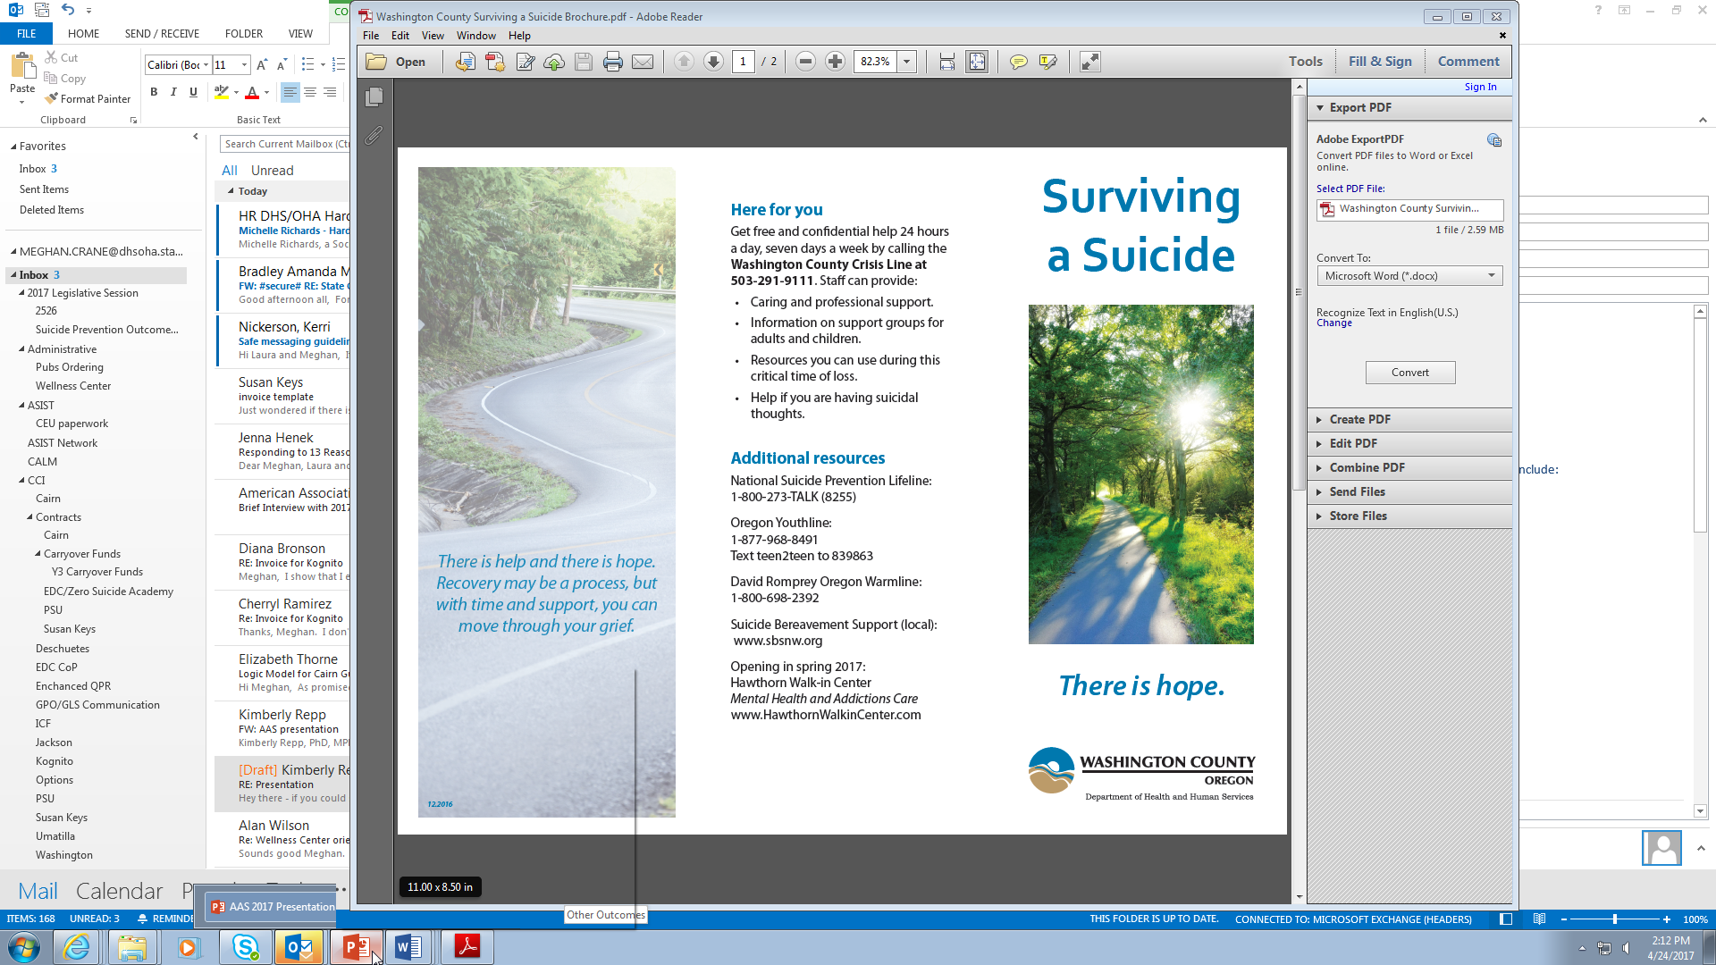
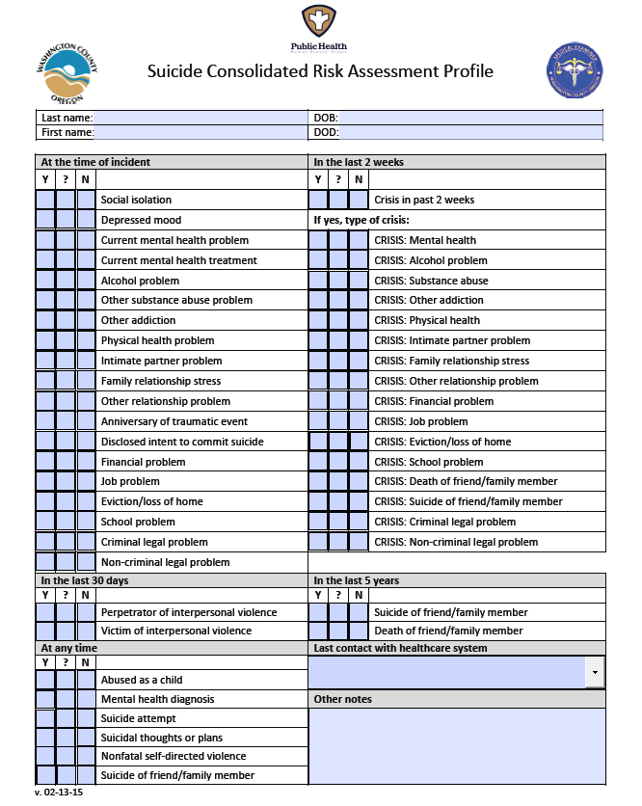
At Time of Death Investigation
Typical Duties of any DME
In addition to:
  Pamphlet
  CRAP Form completed within 24 hours and entered into the WC Suicide Risk Factor Surveillance System
https://washingtonhhs.co1.qualtrics.com/jfe/preview/SV_6ytmtqBzpGqwUvz?Q_SurveyVersionID=current&Q_CHL=preview
Notes:
CRAP for has two additional social isolation and NSSI. DME completes within 24 hours and enters data into the Suicide Risk Factor Surveillance System

Slide 17
Suicide Fatality Review
Six months after death next of kin receives a letter from the DME asking to sign permissions to share information to the SFRB from the following:
Washington County Departments and Programs
Washington County District Attorney’s Office
State of Oregon Department of Human Services Departments and Programs
Law enforcement (Federal, State, Local) Departments and Programs
Veterans Administration and Veterans Services
Healthcare representatives (Hospitals, Providers, Coordinated Care Organizations)
Mental health representatives (Hospitals, Providers, CCO’s, NAMI)
Local and Na􀆟onal Crisis Line representatives
Faith Community representatives
Education, School District, College/University representatives
Notes:
About 20% will send back a signed form

Slide 18
SFR Meeting
  Meeting structure
    Meets four times yearly for two hours
    Max of 5 cases reviewed per session
    Prior to each review, team members sent case files and CRAP form
  Case review procedure
  DME reviews case file
  Team members share their own case-specific information
  Clarifying questions
  Protective and Risk Factors Modular Approach
    RAID team member collects data during meeting
    Suicide Prevention Coordinator records all recommendations
  Self care
Notes:
Adam

Slide 19
SFR Members
Washington County
Community Members
RAID (Epidemiology)
Emergency Medical Services
Medical Examiners
Mental Health
Developmental Disabilities
Commitment Team
Sherriff's Office
District Attorney’s Office
Disability and Veteran Services
HEPP
  Lines for Life
  (local national suicide prevention lifeline provider)
  Washington County Crisis Team
  (contracted to local behavioral health non-profit)
  School District
  (mental health care coordinator)
  Local Chaplin
  Local Hospital Representative
  (inpatient behavioral health unit nurse manager)
  Portland Veteran’s Association
  (suicide prevention coordinator)
  Local ambulance services rep
  Federal Bureau of Investigation
  (operations specialist)

Slide 20
Protective & Risk Factor Modular Approach
 | Protective Factors
 | Effective clinical care for mental, physical, and substance abuse disorders | Strong connections to family and community support | Reduce access to highly lethal means of suicide
RISK FACTORS: Social isolation | Research training for vision practitioners Work with hospital ED on screening/identification Peer support connection resources through hospital? | Training for neighbor- offer QPR for neighborhood watch groups? Veteran support groups in county- how do they connect with vets? | Training on means reduction at hospital Engage veteran support groups in education/training
Alcohol problem | Screening and interventions for alcohol abuse at hospital What VA services are available? | Connect with AA and similar programs to provide awareness/education | Patient, community, and provider education on link of alcohol use and suicide attempt
Eviction/loss of home crisis | What kind of support can the hospital provide? Does hospital have resources to provide? | List crisis line on eviction notices- who do we need to connect with?
Adapted from: http://www2.isu.edu/irh/projects/ysp/CommunitySuicidePrevention/4PreventionPlanning/PreventionPlanning.pdf
Notes:
Example: 65 year old veteran died by gunshot wound. Found by neighbor of many years. No living family that lives close. VA shares that he came in 6 months ago to have his vision checked and get new eyeglasses. Local hospital shares he came in 6 months ago with ankle injury and was screened for alcohol abuse. He did not identify as being a veteran to the hospital. Offered substance abuse treatment; refused; no suicide screening. Sherriff shares that there was an eviction notice on site and the neighbor confirmed that decedent was worried about where he would go if he was evicted.
Protective factors:
Effective clinical care for mental, physical and substance use disorders
Easy access to a variety of clinical interventions and support for help-seeking
Restricted access to highly lethal means of suicide
Strong connections to family and community support
Support through ongoing medical and mental health care relationships
Skills in problem solving, conflict resolution & nonviolent handling of disputes
Cultural and religious
Other

Slide 21

81%
current depressed mood
56%
current diagnosed mental health problem

Slide 22
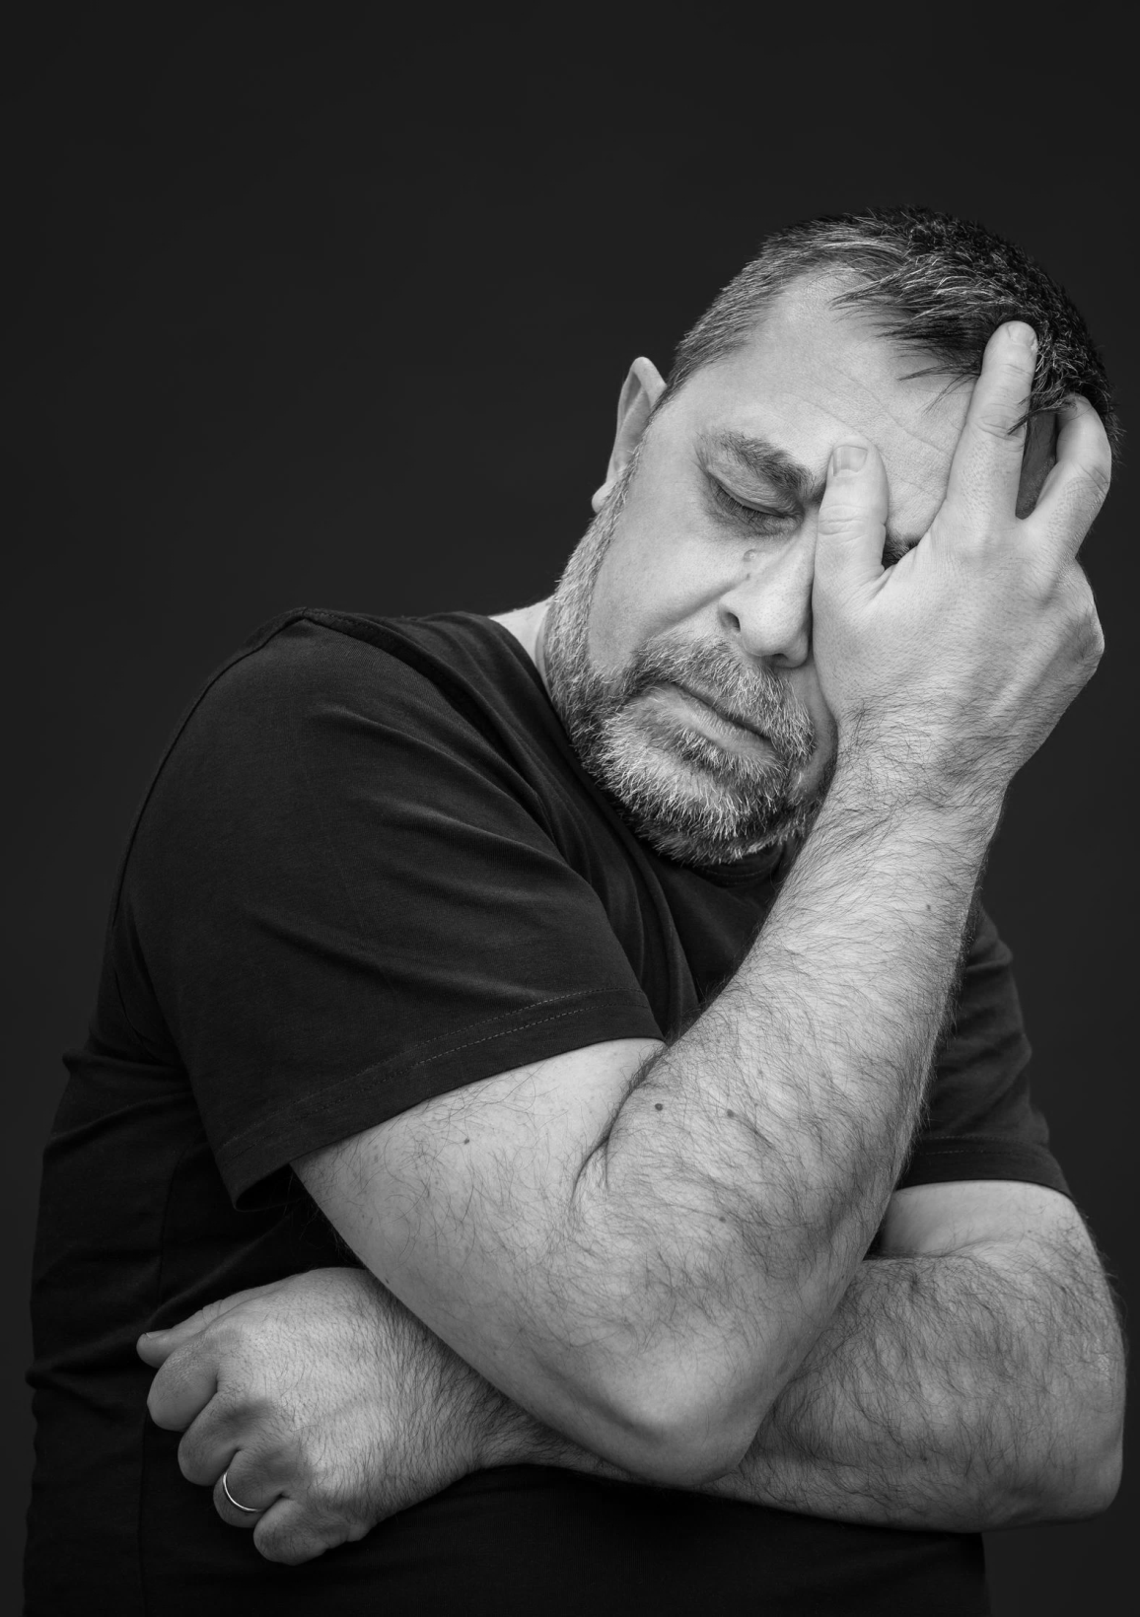

43%
physical health problem
Notes:
The absolute source of the information – every interview. No, missing and unknown are all separated.

Slide 23

72%
major crisis in the previous two weeks
28%
criminal and/or civil legal problems

Slide 24

15%
Eviction or loss of housing problem

Slide 25

49%
healthcare contact
within two weeks of death
69%
within 30 days

